Slide 1

Energy Optimizations For Memory Architectures
Mukesh Sekar
Electrical and Computer Engineering
Colorado State University
Fort Collins, Colorado
msekar@.colostate.edu

Slide 2

Introduction
This slide serves as a foundational framework for our presentation, emphasizing the critical need for energy-efficient computing solutions amidst escalating energy demands. Traditional architectures, prioritizing performance, now confront significant challenges due to the exponential rise in energy consumption. Our survey addresses these challenges head-on, exploring strategies to optimize memory architectures within the realm of energy-efficient computing. By mitigating the relentless growth of data and computational complexity, we aim to pave the way for sustainable computing solutions.

Slide 3
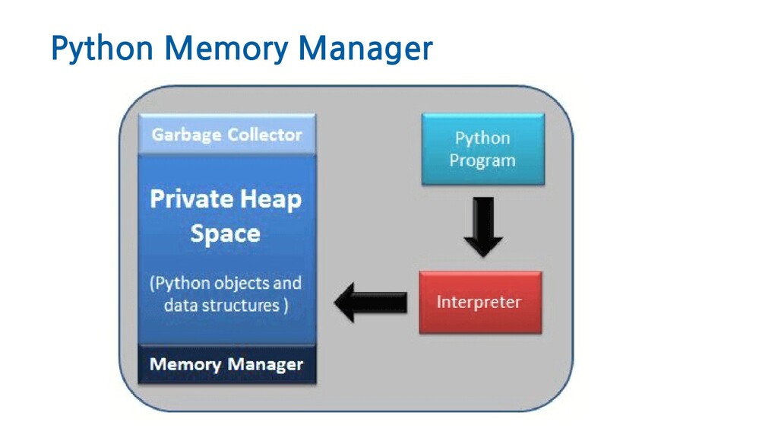
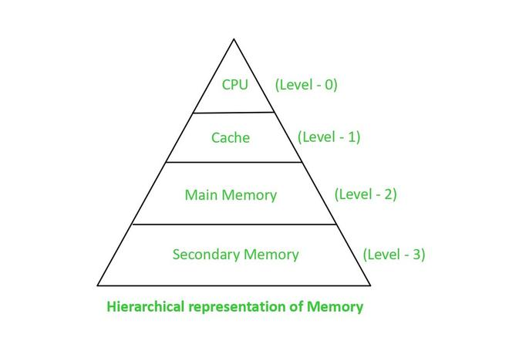
Related Work
A comprehensive overview of existing research efforts in energy optimizations for memory architectures. It delves into the challenges and advancements in shared memory models, emphasizing the struggle to integrate them seamlessly with dynamic languages like Python due to inherent limitations. Additionally, it addresses memory subsystem optimization strategies, highlighting the necessity of balancing energy efficiency with performance gains across diverse applications. Furthermore, the concept of hybrid memory architectures combining SRAM and NVM technologies is explored, along with the challenges of effectively leveraging their strengths while mitigating weaknesses. Lastly, the focus shifts to ensuring predictability and performance in real-time embedded systems with NVMs, underscoring the importance of maintaining deterministic behavior while optimizing energy consumption. Overall, this slide offers valuable insights into the existing research landscape and sets the stage for exploring innovative solutions to address these challenges.
By covering these related works and their associated challenges, the audience will gain an understanding of the existing research landscape and the key areas that need to be addressed to achieve energy optimizations for memory architectures.

Slide 4
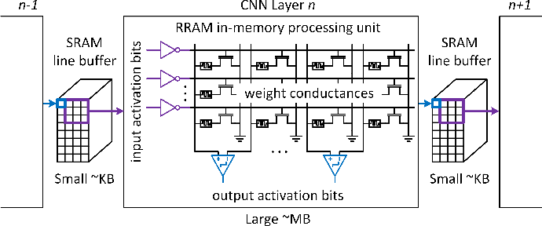
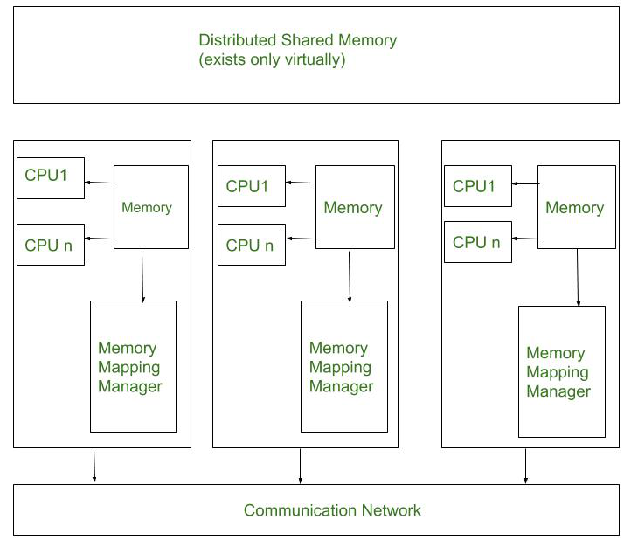
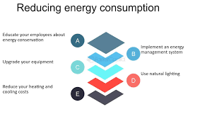
Design and implementation
A diverse array of approaches aimed at optimizing memory architectures for enhanced energy efficiency. It highlights the innovative concept of a software-based distributed memory management system, showcasing its departure from traditional structural designs by leveraging software parameters for more effective management of distributed shared address spaces. This approach offers increased flexibility and adaptability, allowing real-time adjustments tailored to specific applications and system configurations. Furthermore, the integration of a sequential consistency mechanism ensures coherent access across processes, thereby mitigating potential errors and improving overall system reliability.
This slide delves into the co-optimization of device engineering and architecture design for RRAM-based In-Memory Computing (IMC) systems, focusing on addressing non-ideal behaviors in RRAM devices such as random telegraph noise (RTN) and retention degradation (RD). The proposed architectures, such as the Lattice architecture and MobiLattice block, aim to enhance efficiency and performance in RRAM-based IMC systems. Furthermore, the development of simulation frameworks like PIMulator-NN facilitates architectural modeling and optimization, contributing to advancements in RRAM-based IMC systems.
cache optimization using TECH-DoE, a mechanism employing Design of Experiments (DoE) techniques to systematically tune two-level cache memory hierarchies. By iteratively adjusting cache parameters based on their influence, TECH-DoE minimizes energy consumption while preserving performance. Implementation using tools like SimpleScalar and eCACTI enables efficient exploration and evaluation of cache configurations, ultimately leading to optimized memory architectures.

Slide 5
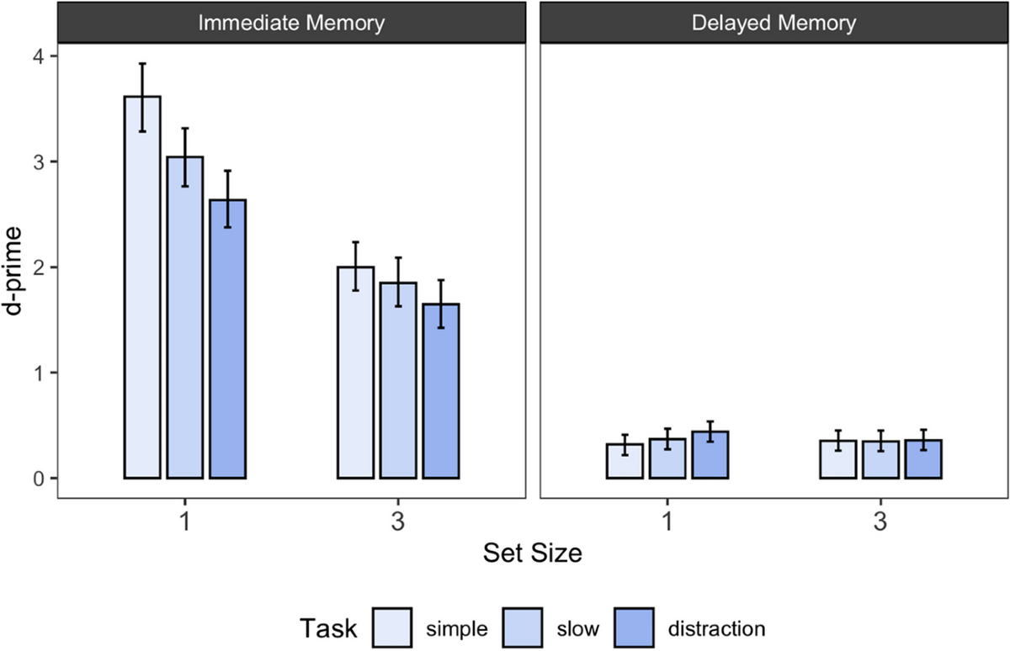
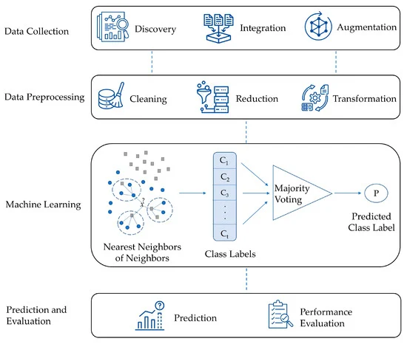
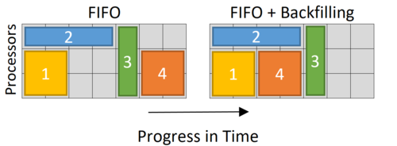
This slide focuses on a pivotal scheme designed to optimize job scheduling efficiency within High-Performance Computing (HPC) systems.
kNN-based Runtime Prediction Method: The incorporation of a kNN-based runtime prediction method is introduced, leveraging historical data to forecast the execution time of submitted jobs accurately. By comparing predicted runtimes with user-provided estimates, the scheme calculates the deviation used as the delay threshold. Detailed algorithms provided in the paper offer insights into calculating the delay threshold, identifying backfillable jobs, and predicting job runtimes, essential for implementing this scheme effectively in HPC systems.
Delay Threshold Determination: It discusses the innovative aspect of Deviation Backfilling in determining the delay threshold for the first job in the queue. This determination relies on the deviation between user-provided runtime estimates and system-predicted runtimes. The slide highlights the dynamic and adaptive nature of this threshold mechanism, crucial for making judicious scheduling decisions in real-time.
Backfilling Approach for Job Scheduling: The slide introduces the concept of backfilling, a strategy where shorter jobs are permitted to execute before longer ones without significantly delaying the latter. This approach enhances overall system throughput while improving resource utilization and reducing potential wastage, crucial factors in HPC environments characterized by high demands for computational resources.

Slide 6
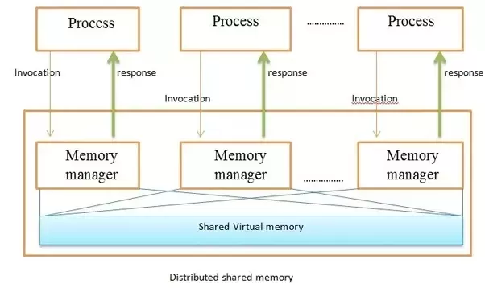
Extending SharedArray Library
  Create NumPy arrays backed by shared memory
  Enables shared NumPy array creation
  Facilitates efficient data reuse across processes
  Mitigates serialization/deserialization overhead
Integration with PyCOMPSs
  Modifications to PyCOMPSs task decorator
  "Recurrent read-only" flag for task arguments
  NumPy arrays loaded/retrieved from shared memory
  Internal dictionary for shared memory management
  Enhances usability for data-intensive applications
Groundbreaking methodology
Extends Python's capabilities
Enables system-wide shared memory
Integrates with PyCOMPSs programming model
Key Advantages
  Enhanced performance and scalability
  Efficient distributed computing in Python
  Seamless shared memory access
  Optimized for data-intensive applications

Slide 7
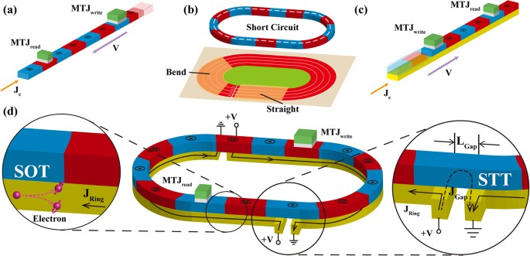
Weight-based parallel Booth multiplier architecture Introduce the proposed weight-based parallel Booth multiplier architecture, which departs from conventional adder array designs.
Introduction of Weight-Based Parallel Booth Multiplier Architecture**: Introduce the novel weight-based parallel Booth multiplier architecture as a departure from conventional adder array designs, offering potential improvements in speed and resource utilization.
Utilization of Racetrack Memory-based Adders**: Explain how the architecture parallelizes the addition of partial products using racetrack memory-based adders, leveraging the high density of racetrack memory to enhance computational efficiency.
Weight-Based Parallel Addition Technique: weight-based parallel addition technique employed, utilizing 2n adders (n-1 full adders and 1 half adder) to handle computations, where n represents the bit-width of the operation, offering a balance between complexity and performance.
Pipelining Strategy: Highlighting the pipelining strategy employed, where bits of the same weight from different partial products are grouped and fed into designated adders using FIFOs of varying lengths, implemented with racetrack stripes. Emphasize how this approach enhances the throughput of the multiplication process and optimizes resource utilization within the architecture.
Simulation-driven assessment of performance and energy efficiency
SPICE simulations conducted using a 45nm CMOS design kit and a validated racetrack memory model.
the evaluation of design parameters such as radix, architectures, and input bit-widths, enabling a thorough analysis of trade-offs between throughput, area overhead, and energy consumption for different multiplier configurations.
Emphasize the insights gained from the simulations, providing a deep understanding of the performance characteristics of the proposed design.
Introduction of Write Optimization Technique for Racetrack Memory
Pre-storing 0s and 1s in Stripes: The technique of pre-storing 0s and 1s in stripes connected to input Magnetic Tunnel Junctions (MTJs), effectively reducing the need for frequent write operations. These pre-stored values serve as ready-to-use data, eliminating the necessity of writing new data during every operation.
Finite State Machine Control Logic: The implementation of a finite state machine control logic, responsible for orchestrating the read, write, and shift operations within the racetrack memory architecture. This control logic ensures seamless transitions between different states and optimizes the utilization of pre-stored data for efficient computation.
Reduction in Energy Consumption and Processing Time: The significant reductions achieved in energy consumption and processing time as a result of minimizing the need for write operations and substituting them with energy-efficient shift operations. By leveraging pre-stored data and efficient control logic, the optimization technique enhances the overall performance and energy efficiency of racetrack memory systems.

Slide 8

Future Scope and Challenges
1. Tailoring memory architectures for edge computing and IoT demands energy efficiency and reliability.
2. Integrating security directly into memory minimizes energy overhead while enhancing protection.
3. Collaboration among experts fosters innovation in energy-efficient memory solutions.
4. Hybrid memory hierarchies offer scalability by integrating diverse memory technologies.
5. Recycling and renewable energy adoption reduce the environmental impact of memory systems.
6. Low-power design techniques optimize energy efficiency in memory architectures.
7. Performance enhancement techniques, such as parallelism, maximize throughput.
8. Error detection and correction mechanisms ensure reliability in energy-efficient memory.
9. Adaptive strategies optimize resource utilization for dynamic workloads.
10. Cost-effective design strategies make energy-efficient memory architectures viable.
11. Regulatory compliance ensures adherence to standards for energy efficiency and security.
12. Improved user experience is achieved through optimized latency and responsiveness.
13. Continuous innovation drives the evolution of energy-efficient memory technologies.

Slide 9
Conclusion
This Presentation illustrates a spectrum of techniques tailored to confront energy optimization challenges across diverse computing domains, including non-volatile memory utilization, cache hierarchy optimization, and real-time system management. By demonstrating their collective efficacy, the paper underscores their potential to significantly enhance energy efficiency, performance, and scalability within memory architectures. Looking forward, continued research and innovation are imperative to address evolving challenges, strengthen security measures, overcome scalability hurdles, and prioritize environmental sustainability. Emphasizing interdisciplinary collaboration, the field is poised for advancement, fostering innovation and delivering energy-efficient memory architectures capable of meeting the evolving needs of future computing models while minimizing their ecological footprint.

Slide 10

Thank you

